Slide 1
Data features to try and reproduce with the modelling
18 Nov 2015
Note: Prior to 26/5/16, bins had been: {1 2 3 4; 5 6 7; 8 9 10}. After this date, this has been corrected to {1 2 3 4; 5 6 7; 8 9 10}

Slide 2
Background/aims i.e. what is interesting about this study?
Background: Purpose is an active driver of decisions (as opposed to viewpoints that are only consider pleasure -within this framework, certain choices are hard to understand/errors in “rationality”, e.g. having kids)
Questions: (a) How are PL and PP integrated into decisions about how we spend our time, both psychologically and in the brain? (b) What happens when PL and PP come into conflict?
Why are these interesting questions?
Intuitively we know that purpose is relevant to choice, but this has not been demonstrated/quantified, and the neural underpinnings are entirely unknown
Demonstrate that “real world” decisions about how we spend our time rely on the same process as in lab-based choice tasks (PL-PP as standard multi-attribute choice)
Extending basic psychological mechanisms about choice to the understanding of real world decisions, in order to (a) introduce some mechanistic rigour to the study of how we spend our time (b) demonstrate that the mechanisms studied in the lab have validity to real-world choice
E.g. Do pleasure- and purpose-based computation map onto trade-offs between hedonic/impulsive vs goal-directed choice? Uncertainty-based arbitration between option attributes?
Examine multi-attribute choice where attributes are organic (as opposed to abstract, instructed dimensions that correspond to abstract mathematical properties).

Slide 3
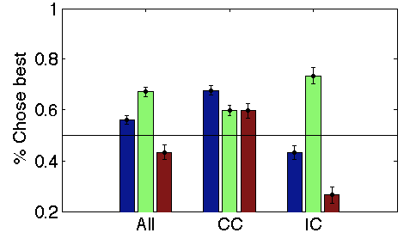
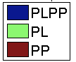
1A. [CC trials] PL & PP scores have some predictive validity, but a simple sum is not fully predictive even where choice is un-conflicted * This headline needs work
CC: Compatible Choice
IC: Incompatible Choice
PL: Pleasure
PP: Purpose
PL & PP scores have some predictive validity
Even where choice is un-conflicted, neither PL, PP or PL+PP explain all the variance
Considerable noise in choice (in aggregate) even on CC trials (where behavioural choice, i.e. Option A/B, is clear)

Slide 4
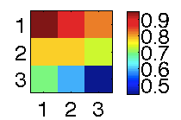
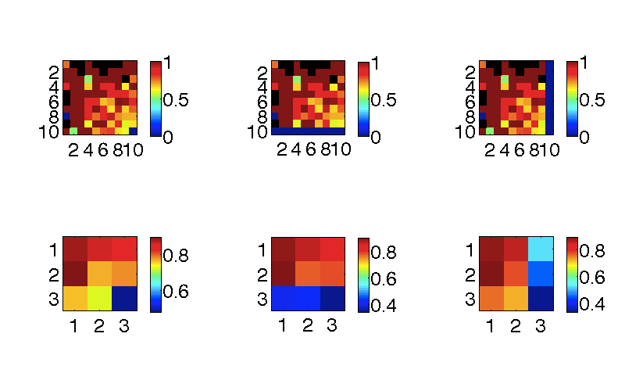
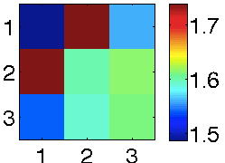
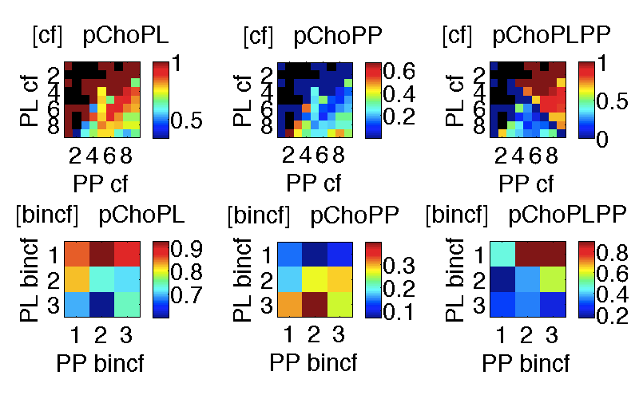
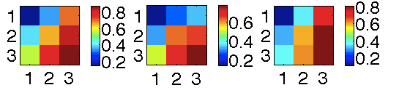
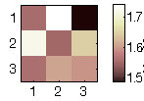
1B. On compatible-choice trials, conflict in both domains affects the likelihood of making the best choice
p(Choose agree w PLPP)
p(Chose max PL)
p(Chose max PP)
RTs
Binned by conflict
(on PL vs PP domains)
p(Chose max PLPP)
p(Chose max PL)
p(Chose max PP)
RTs
Binned by chosen value (on PL vs PP domains)
Noisier choice where there is within-attribute (PL/PP) response conflict, even where both attributes make the same recommendation (i.e choose Option A)
No easily discernible pattern in RTs
Caveats:
Pattern is clear/apparent only in aggregate (less clear looking at individual subjects)
Some of this is due to inherent correlations in PL & PP scores (see later slide)

Slide 5
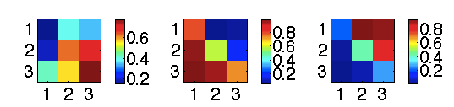
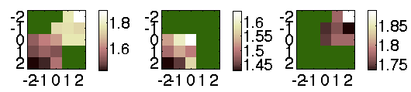
2. Even on IC trials, both PL & PP are taken into account even though 1A would suggest PL is exclusively weighted
p(Chose max PLPP)
p(Chose max PL)
p(Chose max PP)
Binned by chosen value (on PL vs PP domains)
All trials
Chose max PL
Chose max PP
Binned by chosen>unchosen value
Subjects weight PL & PP most equally when they are both valuable
Note ranges/patterns are similar p(Chose max PL) & p(Chose max PP)
But subjects are much slower when they choose to prioritize purpose in their decision (inhibiting Pavlovian pleasure-approach?)

Slide 6
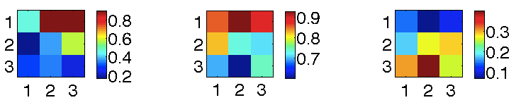
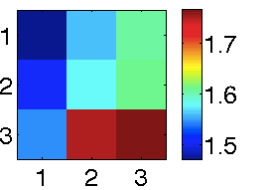
3: Typical value integration may be overridden on IC trials
p(Choose agree w PLPP)
p(Choose agree w PP)
RT
p(Choose agree w PL)
Binned by conflict
Slower
X
(more) slower
Although PL dominates choice, RT betrays an effect of PP on choice
Standard PL/PP integration is likely occurring on IC trials as well, though this process may be overridden/aborted
Salient pattern in the IC data is still quite unclear
Ideally, CC and IC trials should be modelled within the same framework, though ultimately we may be justified in modelling them differently.
Analysis plan: build the ideal/CC-descriptive model, then tweak + simulate to test ideas about what is going on on IC trials
Notes:
Note: Based on simple simulations, binning just according to Vchosen may not be very good in discriminating between different strategies

Slide 7
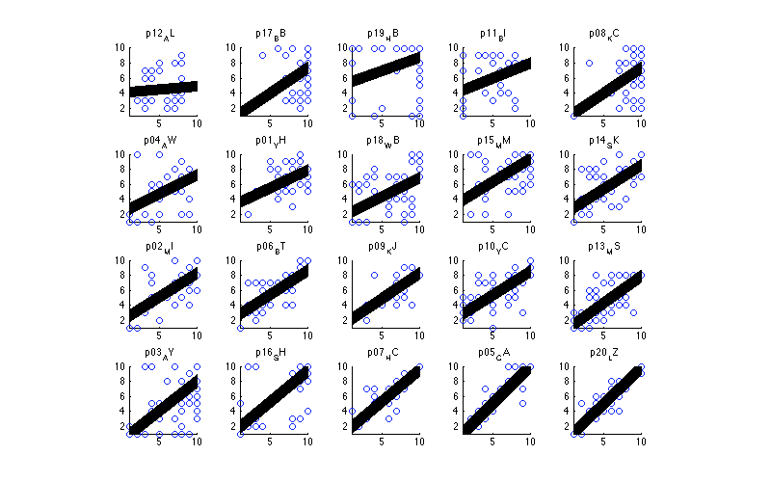
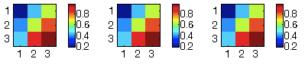
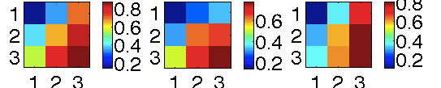
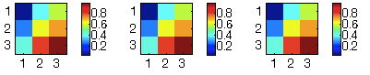
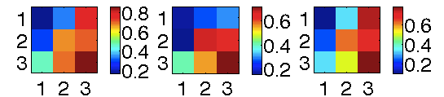
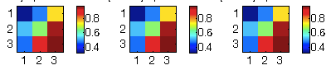
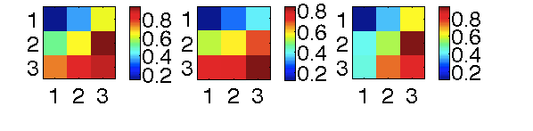
4: Caveat= PL & PP scores are inherently correlated in CC trials, and some of the observed pattern emerges from a PL-exclusive strategy
There is an effect of PP to look for, but we may be slightly hamstrung
Within CC trials, PL & PP are correlated (mean r=.62, SD=0.05). Because of this, simulating a PL-exclusive strategy produces apparent variance as a function of (AVFo)PP.
But, the observed AVFo-PP is greater than what one would see with a PL-exclusive strategy
Practically, this means we may have reduced power. If necessary, may sub-sample subjects w low PL-PP correlation
Note though that Vchosen plots are not very discriminative between different strategies in general (see reports for Simple Simulations, PL-PP corr explore). Plotting by conflict demonstrates the insufficiency of cho-PL strategies (see PL-PP corr explore report)
Choose-PL simulations
Observed choice
p(Chose max PL)
p(Chose max PP)
p(Chose max PL)
p(Chose max PP)
p(Choose agree w PLPP)
p(Choose agree w PLPP)
Overall
Low PL-PP
Corr (CC)
High PL-PP
Corr (CC)

Slide 8
END

Slide 9
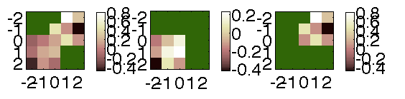
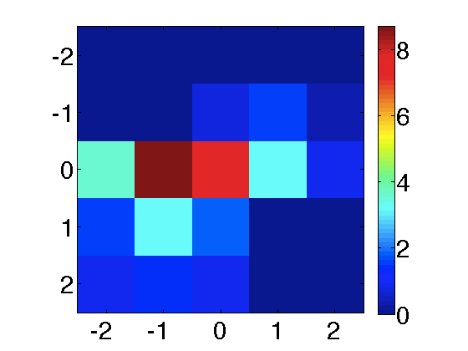
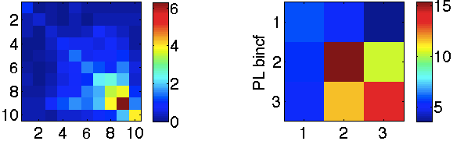
All trials
Chose max PL
Chose max PP
Binned by chosen>unchosen value
RTs log-transformed
Binned by
chosen>unchosen value
RTs z-scored
N trials
Many empty cells (green on the RT plots)
Note the following cells that are not technically empty, just very sparse:
[-2,0] = 0.05
[-2,1] = 0.1
[-2,2] = 0.1
Binned by
chosen>unchosen value
Binned by
conflict

